Slide 1
PRESENTATION OF SZŠ A VOŠZ PLZEŇ the Czech Republic www. zdravka-plzen.cz
Notes:
Ladies and gentlemen,
My name is Ivana Křížová and I would like to present our secondary medical school and medical college.

Slide 2
INFORMATION ABOUT SCHOOL
Our secondary medical school and medical college has a long tradition.
We are the biggest medical school in the West of the Czech Republic with an utmost offer of study programmes.
Our school was founded in 1943. We celebrated the 70th anniversary of the school foundation in 2013.
Notes:
Our secondary medical school and medical college has a long tradition.
We are the biggest medical school in the West of the Czech Republic with an utmost offer of study programmes.
Our school was founded in 1943. We celebrated the 70th anniversary of the school foundation in 2013.
This year 550 pupils and 370 students study at our school. We have 80 internal employees and 70 teachers – especially acclaimed experts from various medical institutions.
Secondary school leavers continue their studies at medical colleges or universities. 90 % of our medical college graduates start their proffesional carrier after graduation.
Our professional equipped school cooperates with social partners like Faculty Hospital Pilsen, Medical Faculty of Charles University in Pilsen, Westbohemian University in Pilsen, hospital Privamed, Child centre Pilsen, St. George Hospital and other 200 contract social partners.

Slide 3
INFORMATION ABOUT SCHOOL
This year 550 pupils and 370 students study at our school. We have 80 internal employees and 70 teachers – especially acclaimed experts from various medical institutions.
Secondary school leavers continue their studies at medical colleges or universities.
90 % of our medical college graduates start
their professional carrier after graduation.

Slide 4
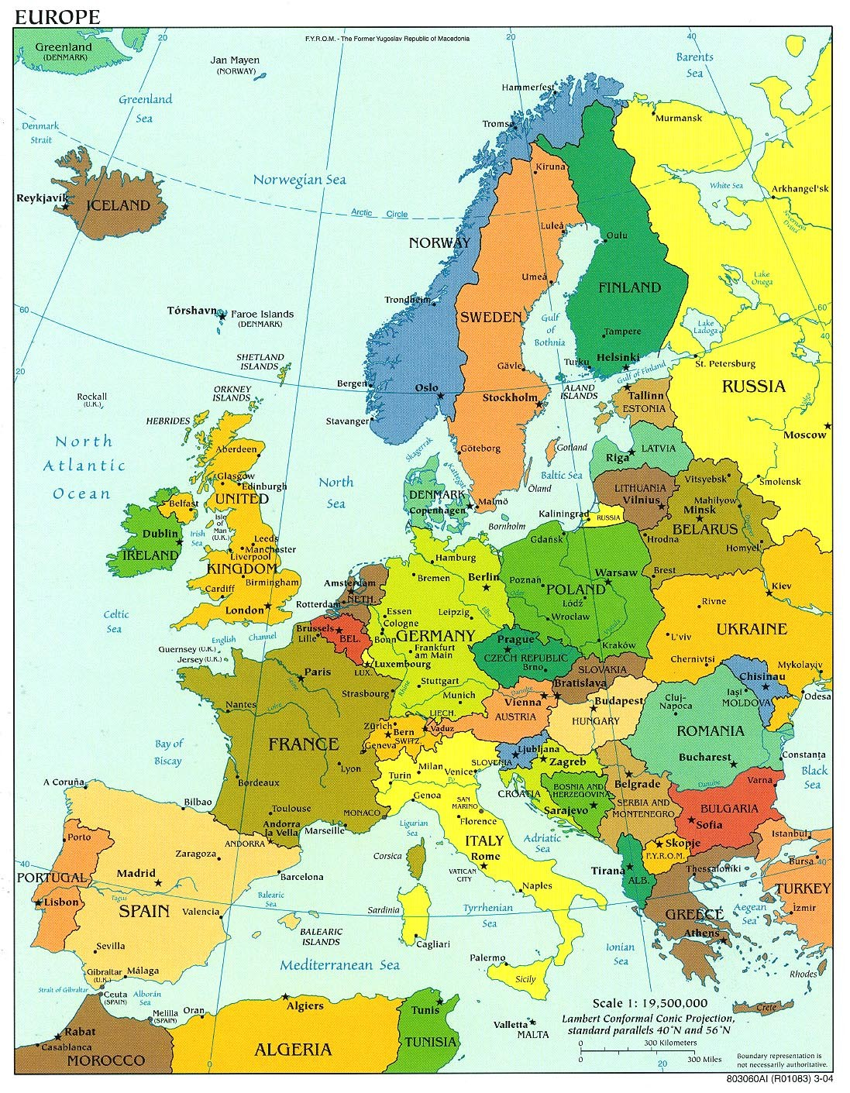

Slide 5
History
28.10.1918 The Republic of Czechoslovakia was formed following the collapse of the after World War I.
17.11.1989 The Velvet revolution- the communist regime collapsed
1.1. 1993, Czechoslovakia peacefully dissolved, with its constituent states becoming the independent states of the Czech Republic and Slovakia
1999 The Czech Republic joined the NATO
2004 The Czech Republic joined the EU

Slide 6
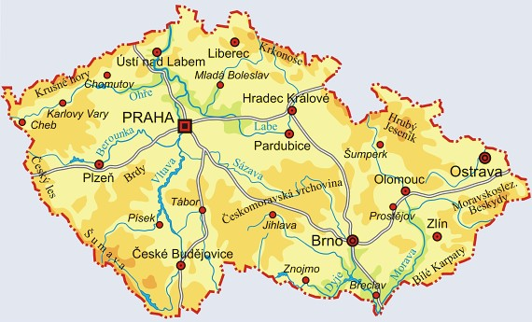

Slide 7
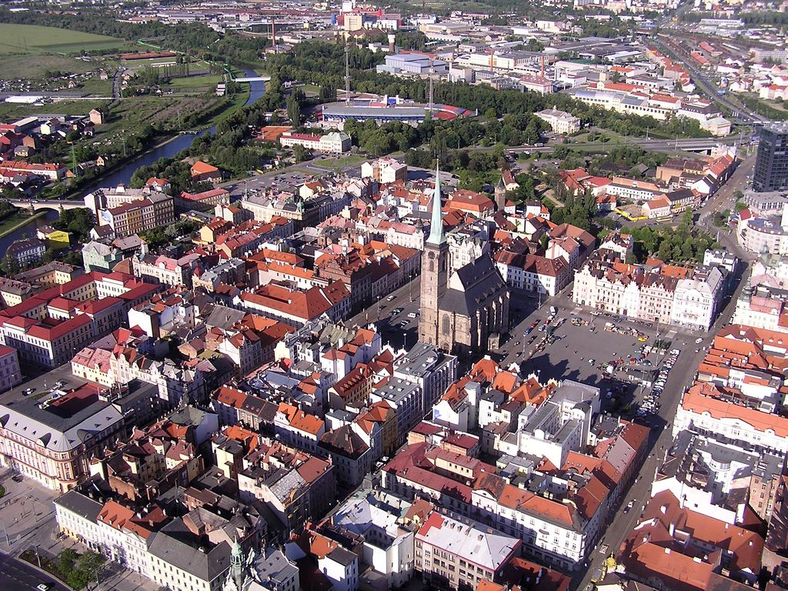

Slide 8
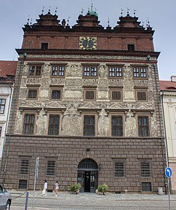
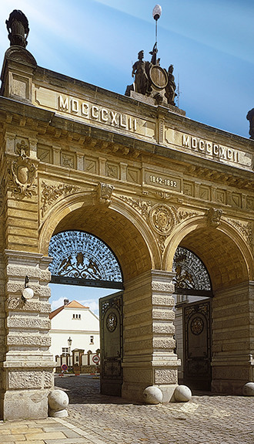

Slide 9
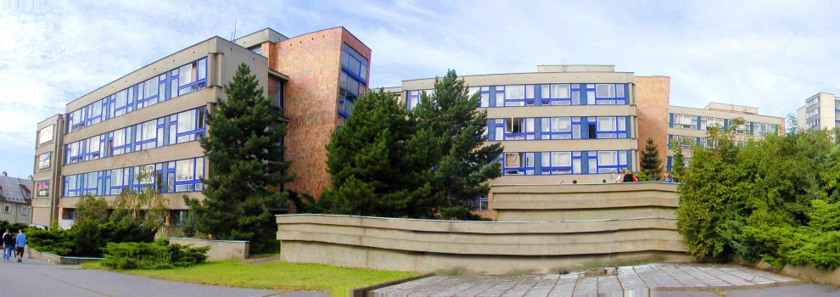

Slide 10
INTERNATIONAL COOPERATION
Erasmus + (running projects)
Two nursing KA1 projects
Project KA 1 Language teaching methodology (for teachers)
Project KA2 No need for another toy, water is our essential joy
Project KA2 United in diversity: UNESCO regional heritage within European identity
Project KA2 Using mobile apps in classes
Project KA2 Innovation in math and ICT
Project KA2 Catch the date

Slide 12
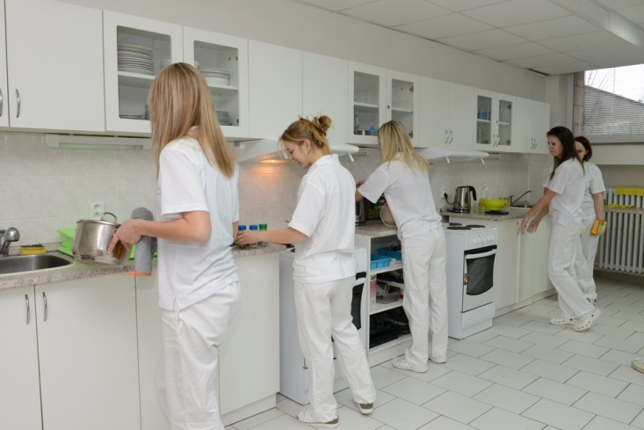

Slide 13
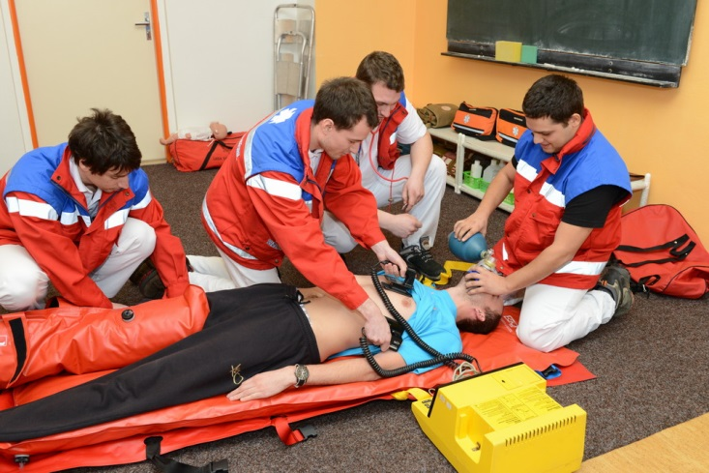

Slide 14
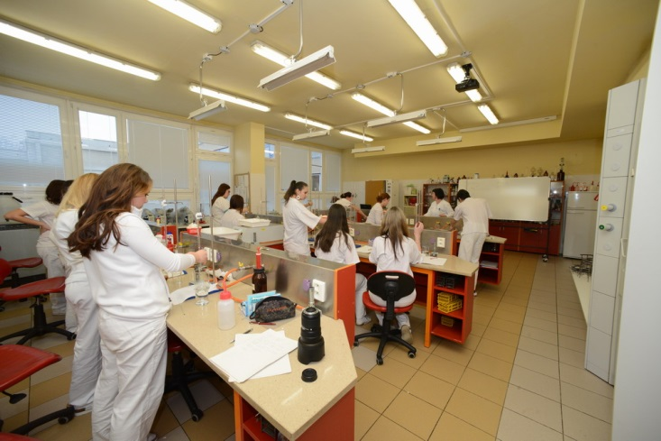

Slide 16
Plzeň
https://www.youtube.com/watch?v=pt78yCI3-y8

Slide 17
Motto….“ once we will be patients too…“
Thank you for your attention!

