Slide 1
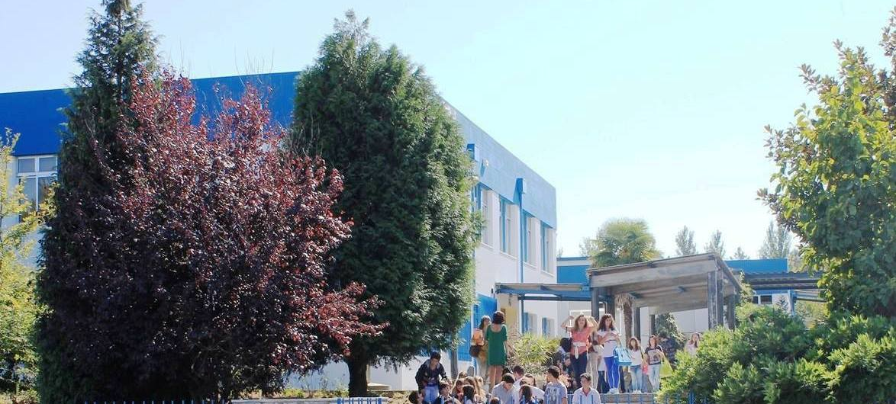
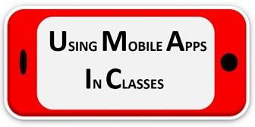
THE PORTUGUESE EDUCATIONAL SYSTEM
ESCOLA SECUNDÁRIA DE BARCELINHOS

Slide 2
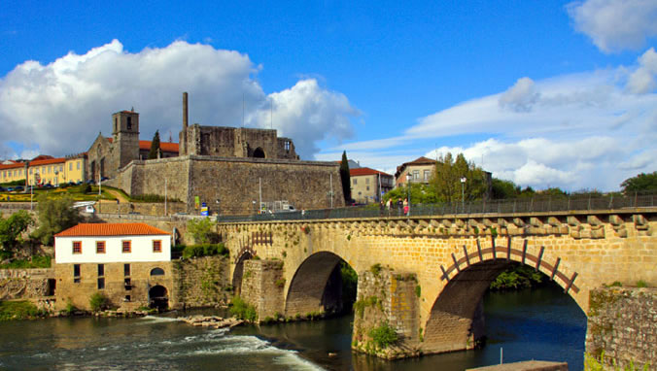
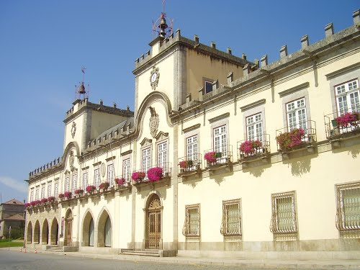
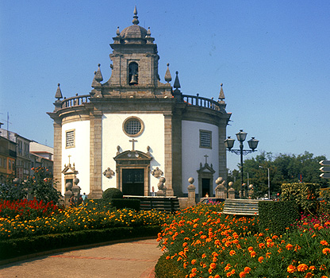
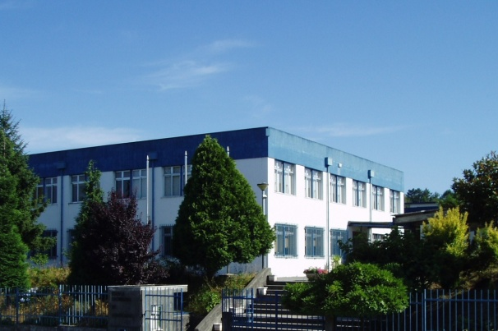
BEM-VINDOS!
Vítejte! Welcome!

Slide 3
PRE-SCHOOL
1st CYCLE
2nd CYCLE
3rd CYCLE
SECONDARY
Nursery
Kindergarten
HIGHER EDUCATION
1st year
2nd year
3rd year
4th year
5th year
6th year
7th year
8th year
9th year
10th year
11th year
12th year
1st cycle
2nd cycle: masters
3rd cycle: doctorate
BASIC EDUCATION
COMPULSORY EDUCATION
until age 18
THE PORTUGUESE EDUCATIONAL SYSTEM

Slide 4
PRE-SCHOOL
1st CYCLE
2nd CYCLE
3rd CYCLE
SECONDARY
Nursery
Kindergarten
HIGHER EDUCATION
1st year
2nd year
3rd year
4th year
5th year
6th year
7th year
8th year
9th year
10th year
11th year
12th year
1st cycle
2nd cycle: masters
3rd cycle: doctorate
ESCOLA SECUNDÁRIA DE BARCELINHOS
THE PORTUGUESE EDUCATIONAL SYSTEM

Slide 5
3rd CYCLE
SECONDARY
7th year
8th year
9th year
10th year
11th year
12th year
Vocational/
CEF courses
Portuguese Language
Mathematics
English (levels 3, 4 and 5) B1
French (levels 1, 2 and 3) A2+
Natural Sciences
Physics and Chemistry
History
Geography
Physical Education
Visual Arts
Technological Education (Crafts) – year 7 + 8
ICT – year 7 and 8
Civics Education
Catholic (or other confessions) Moral and Religious Education (optional)
12-14 subjects
Exams Year 9
ESCOLA SECUNDÁRIA DE BARCELINHOS

Slide 6
3rd CYCLE
SECONDARY
7th year
8th year
9th year
10th year
11th year
12th year
REGULAR COURSES
ARTISTIC COURSES
VOCATIONAL COURSES
ESCOLA SECUNDÁRIA DE BARCELINHOS

Slide 7
SECONDARY
10th year
11th year
12th year
Exams Year 11 + 12
Sciences and Technology
Social and Economic Sciences
Languages and Humanities
REGULAR COURSES
Tourism - Rural and Ecological
Sports Management
Computing and Management
VOCATIONAL COURSES
3 compulsory exams
Professional qualification: level 4
Training period – year 11 & 12
ESCOLA SECUNDÁRIA DE BARCELINHOS

Slide 8
Our School
3rd Cycle – 9 classes
+ 1 CEF class
213
70 teachers
Secondary | Regular courses – 13 classes
1 Special Needs teachers
274
1 Psychologist
Secondary | Vocational courses – 7 classes
124
20 Assistant staff

Slide 9
Our School – schedule
Classes: segments of 45 and 90 minutes
2 breaks in the morning and 2 in the afternoon.
Morning period: 8:20 a.m. to 1:15 p.m.
Afternoon period: 1:25 p.m. to 6:20 p.m.

Slide 10
Our School – Non-curricular activities
Citizenship skills
Health and sex education
Cyber-safety awareness
Media literacy and financial education
Entrepreneurship and consumer education
Integrated in different subjects

Slide 11
Our School – Extracurricular activities
Drama Club
Robotics Club
Desporto Escolar – sports programme (table tennis, Mountain bike, volleyball, canoeing…)
LanParty
Erasmus+ Project
Schola Magazine
Minha Escola de Ciências – My School of Sciences
Youth Parliament…

Slide 12
Our School – SEI+ Project & GAMC
Extra 45-minute lesson per week (subjects that are tested by national exams)
Co-teaching
Tutoring
Common assessment instruments
Exam preparation sessions (June)
Collaborative work
GAMC – conflict mediation / mitigating misbehaviour
Strategies to promote students’ success @ school

Slide 13
OBRIGADO.
Děkuji. Благодаря ти. Teşekkürler.
Thank you.

